Slide 1

Study Battery Resistance with Temperature
Siddharth Pachpor
Date : 21-09-2022

Slide 2
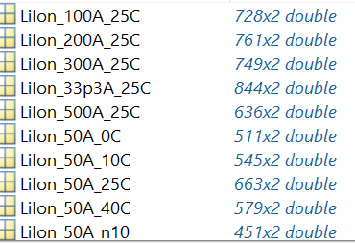
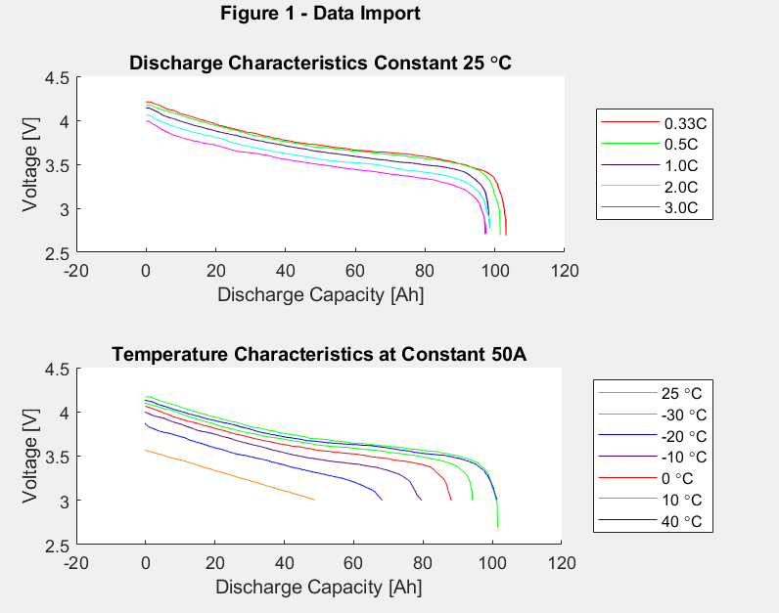
Challenge 1: How to deal with data structures? How to extract relevant data?
The data sets each have two columns. The first column contains the discharge capacity, in percent. The second column contains the corresponding battery cell voltage
Plot the discharge data curve at a Ref. Temperature(T) and Ref. Current (I)
.
Concept Learned: Plotting, data structures access and parsing, sorting, looping
1

Slide 3
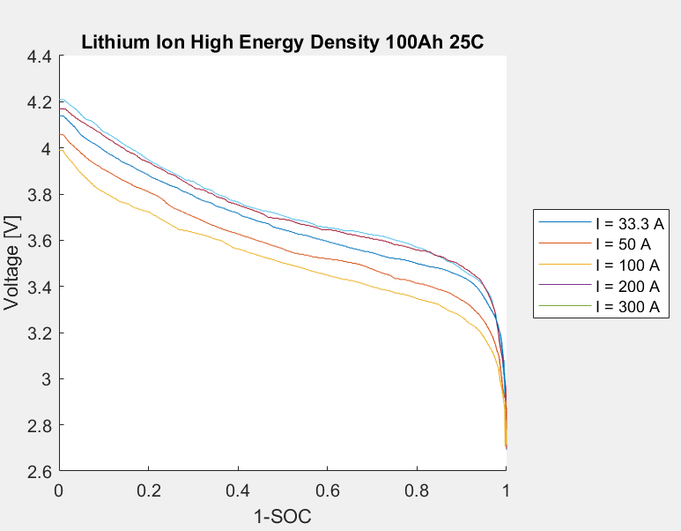
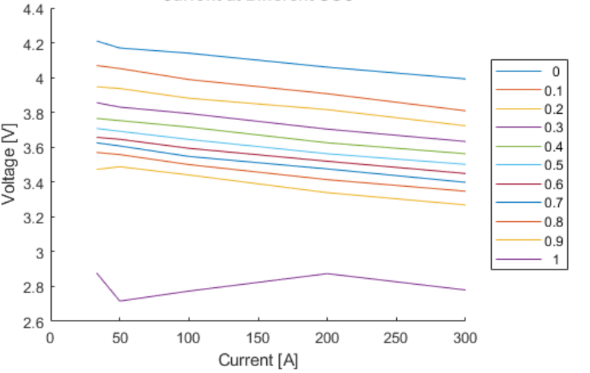
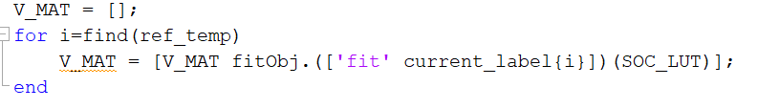
Challenge 2: How to work on fitting concepts?
Create fitObj curves for Constant T @ different discharge rates and Constant discharge rates @ different T.
Fit discharge curves at different Currents for Ref. Temperature
Create a matrix that has Voltage vs Discharging currents at varying levels of SoC.
FitObj Structure fits Dis. Voltage to normalised [0,1] extracted Ah.
The discharge curves are combined to calculate resistance at each SoC
V_mat = SOC in rows and the current in columns.
Concept Learned: Fitting concepts, use of poly1 fitting function, matrix creation
1

Slide 4
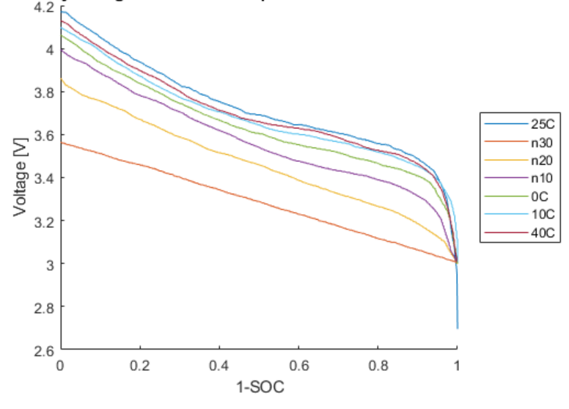
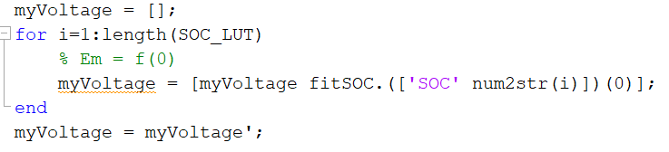
Challenge 3 : How to obtain OCV?
If I fit a line to the Voltage versus current curve and extrapolate to i=0, I get OCV where V = f(Current)
And then to, estimate this open circuit voltage, myVoltage , at all SOC levels, extrapolate the values of voltage to i=0
Concept Learned: Fitting concepts, extrapolation
1

Slide 5
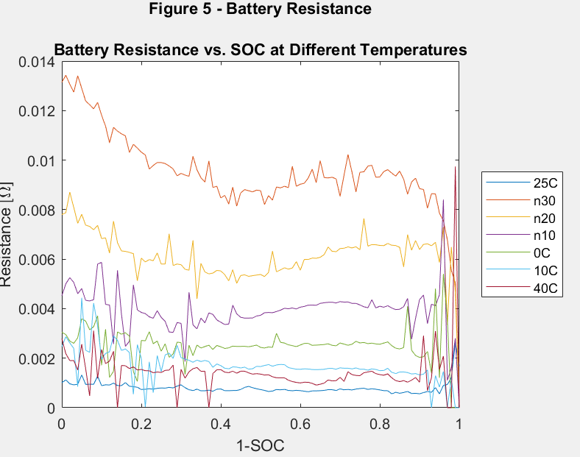

Challenge 4: How to get a resistance relation with temperature?
Use the discharge and temperature data to determine the battery resistance as a function of current and SOC at varying temperatures.
Interpretation: High R @ negative Temperature
Also , T increases when R decreases
Hurdle : Why is there cluttering at full Battery discharge ?
Future work : A validation to this curve fit can be done by comparing to the Arrhenius behaviour.
Reason : Temperature-dependent reaction rate for the lithium-ion battery follows an Arrhenius behavior, slope of the internal resistance vs T, for different SOC
1

Slide 6
CC/CV Battery charging Implementation

Slide 7
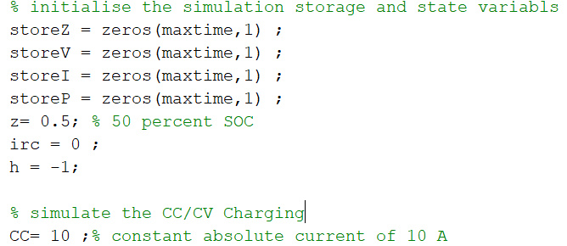
Process Implementation
Constant-current/constant-voltage (CC/CV) -- A constant charge current is applied to the cell until the cell reaches some predetermined maximum voltage. The cell’s terminal voltage is then held at this maximum value until charging current becomes negligibly small.
Capture all the parameters like total capacity, time constant, diffusion resistance, hysteresis max voltage, hysteresis rate gamma, series resistance from open-source file. Store it in a struct and then access the struct fields.
1

Slide 8
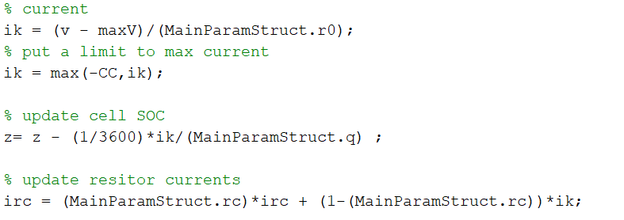
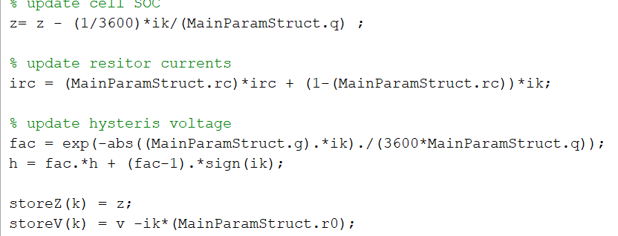
Parameter update process
maxV = 4.15;
maximum cell voltage of 4.15 V
The code loops through max time iterations (3000), updating the state and voltage predictions every time step.
Parameters such as cell SoC, resistor currents, hysteris voltage, are updated along the 3001 iterations
1

Slide 9
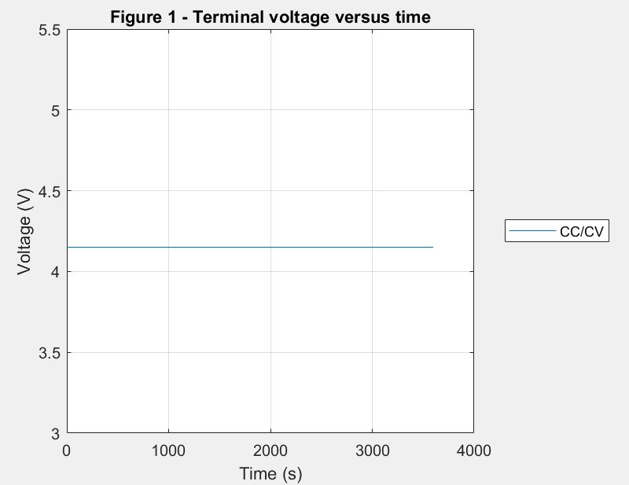
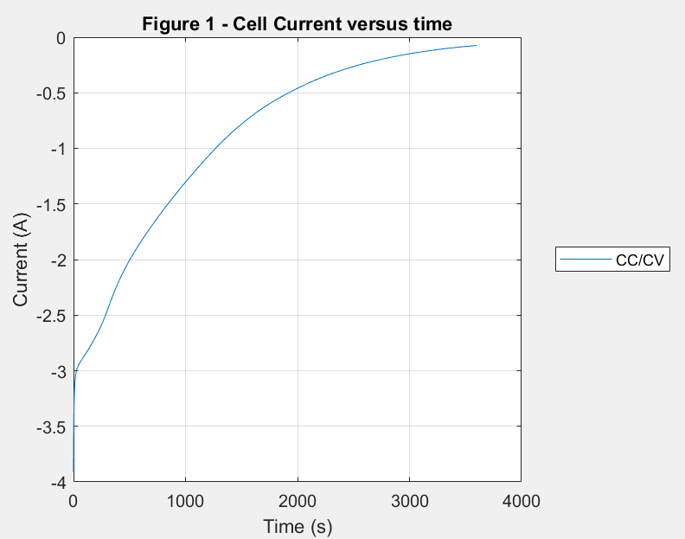
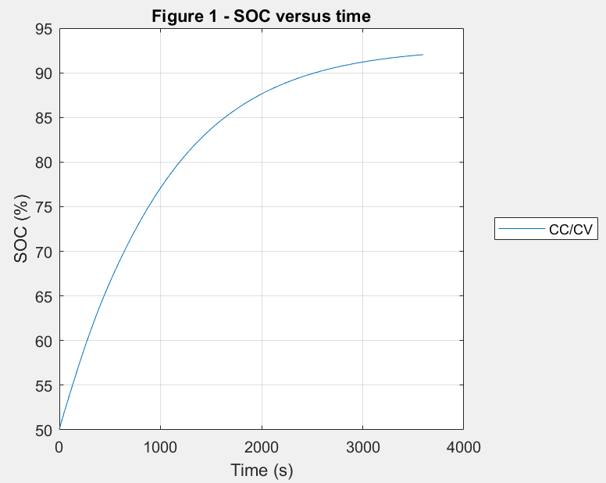
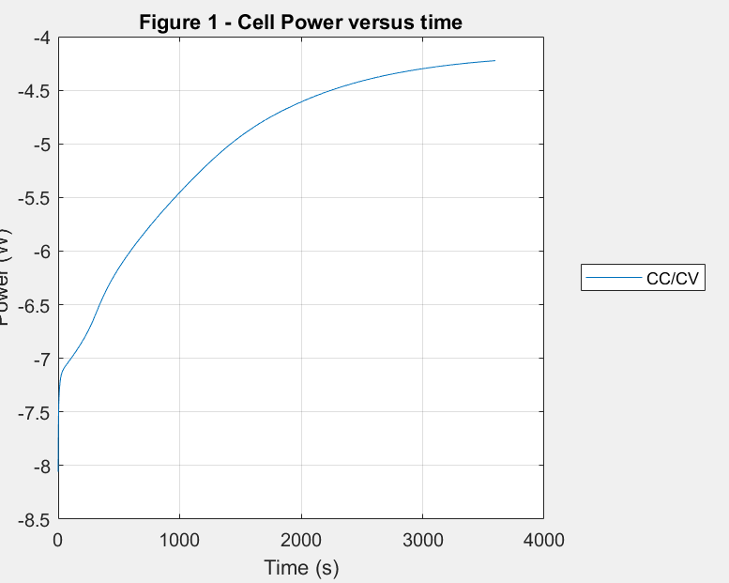
Results
1

Slide 10
Li Ion Intercalation on Anode graphite

Slide 11

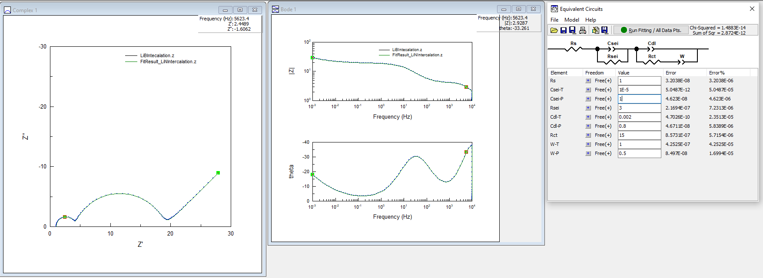
LIB Intercalation- Fitting Exp.data vs Empricial data
Fitting Electroscopic impedance Spectroscopy experimental data over empirical data for Rs, Csei, Rsei, Cdl, Rct, Warburg impedence for low and high frequency data points
1

Slide 12

Thank You
4

